Slide 1
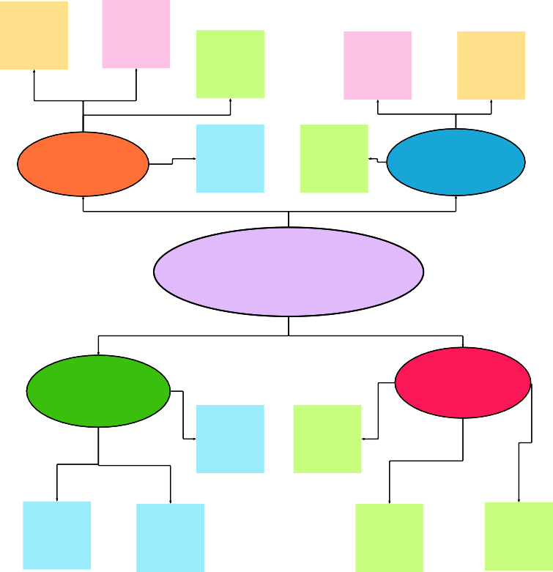
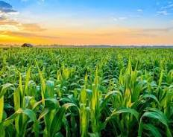
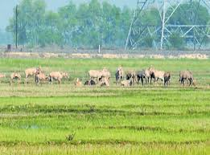
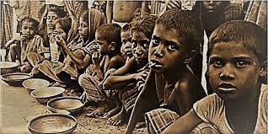
1
Define your problem statement
What problem are you trying to solve? Frame your problem as a How Might We statement. This will be the focus of your brainstorm.
2
Brainstorm
Write down any ideas that come to mind that address your problem statement.
10 minutes
3
Group ideas
Take turns sharing your ideas while clustering similar or related notes as you go. In the last 10 minutes, give each cluster a sentence-like label. If a cluster is bigger than six sticky notes, try and see if you and break it up into smaller sub- groups.
20 minutes
4
Prioritize
Your team should all be on the same page about what's important moving forward. Place your ideas on this grid to determine which ideas are important and which are feasible.
TIP
Participants can use their cursors to point at where sticky notes should go on the grid. The facilitator can confirm the spot by using the laser pointer holding the H key on the keyboard.
Before you collaborate
A little bit of preparation goes a long way with this session. Here’s what you need to do to get going.
10 minutes
After you collaborate
You can export the mural as an image or pdf to share with members of your company who might find it helpful.
TIP
You can select a sticky note and hit the pencil [switch to sketch] icon to start drawing!
TIP
Add customizable tags to sticky notes to make it easier to find, browse, organize, and categorize important ideas as themes within your mural.
5 minutes
20 minutes
Brainstorm
& idea prioritization
Use this template in your own brainstorming sessions so your team can unleash their imagination and start shaping concepts even if you're not sitting in the same room.
Group ideas
_{A} Team gathering
Define who should participate in the session and send an invite. Share relevant information or pre-work ahead.
PROBLEM STATEMENT
Quick add-ons
HARIHARAN J
VINOTH KUMAR M V
VIGNESH E
ABISHEAK KUMAR K P
identifying of animals detection using vision API
statistical recording of animals movement in data storing method
_{A} Share the mural
Share a view link to the mural with stakeholders to keep them in the loop about the outcomes of the session.
arduino and sensor based Animals monitoring
system
identifying of movement of animals near the fileld
Image recording of animals movement values in data storing method
Image based animals data to detect animal
Detect animals using animals image datas
algorithm encryption and decryption datas of movement of animals
arduino and sensor based animals detection
_{B} Set the goal
Think about the problem you'll be focusing on solving in the brainstorming session.
Farmers grow their crop on field near any forests and also many animals live near the field. so that they grow better but these
Animals due to their food unavailability they are destroys the agriculture field.
predicting the detection of animals
B Export the mural
Export a copy of the mural as a PNG or PDF to attach to
emails, include in slides, or save in your drive.
app developing
for detecting
animals movement
In crop
field
monitoring
Learn how to use the facilitation tools
Computer vision API system is connected with arudino
measuring device based two cameras and image processing
app developing for detecting movement of animals in crop fields
Humans directly come to farm field and detect the movement of animals
C
Use the Facilitation Superpowers to run a happy and
productive session.
10 minutes to prepare
1 hour to collaborate
2-8 people recommended
Animals
detection
Computer vision API connected with arudino
predicting the Movement of animals using conventoinal method
predicting analysis
Keep moving forward
Strategy blueprint
Define the components of a new idea or strategy.
Open the template
Open article
Computer
vision API
system to
capture the
image of animals
prefixed values in Arduino monitors the movements of animals
cloud data based microcontroller node mcu used for monitoring
predicting the detection of animals
Camera is used to detect animals in farm field
ultrasonic radiation for animals control
MEMBERS OF THE IDEATION PROCESS:
TEAMLEAD: HARIHARAN J
TEAM MEMBER 1: VINOTH KUMAR M V
TEAM MEMBER 2: V I G N E S H E TEAM MEMBER 3:ABISHEAK KUMAR K P
TODAY'S DISCUSSION TOPIC:
Customer experience journey map
Understand customer needs, motivations, and obstacles for an experience.
Open the template
GSM modules to transfer the movement of animals to mobile applications
algorithm encryption and decryption datas of movement of animals
Project developed using IBM watson platform
UV Radiation sensor are used to drive away the animals
Smart crop protection system for agriculture
So,the animals for their basic needs ,they destroys the field and eat all the crops in agriculture filed.
Importance
If each of these tasks could get done without any difficulty or cost, which would have the most positive impact?
alerting animals movement to locals through Wi-Fi
Strengths, weaknesses, opportunities & threats
API system is used to moniter the movement of animals
API system application foran i mal monitoring
wireless network based data collection
Drive away animals using fences and creating sounds
Identify strengths, weaknesses, opportunities, and threats (SWOT) to develop a plan.
Open the template
GSM module to alert the user for animal detection
Wifi module network to sensor resultant data
Alerting animals movement to locals through Wi-Fi
forming mesh network using sensor to better monitoring
predicting the movement of animals using conventoinal method
Computer vision API
manual work
Computer vision API system for detecting movements of animals
Share template feedback
arduino and sensor based animals detection monitoring
manual checking of animals movement in crop fields
ultrasonic radiation for animal control
Physical changes and identification of crops by image processing method
Without hurting animals , drive away the animals
Ideas for monitoring the Animals without destroying the farm field
The animals are attack the field and crops are converted into a waste material . This leads to foods or grains unavailability are increases in all over the world. Due to this problem ,country loses a economic value.
UV radiation method after detection
animals
Creating ultrasonic radiation to control the animals without entering into the filed
Creating rays sensor to move aways the animals from farm
After detection of animals ,the can be moved away by the humans by creating sounds
manual checking of animals in crop field is more
ultrasonic radiation for animals control
GSM modules to collect and transfer animals movement data to mobile applications
Settin up the project kit in the agriculture field without disturbing other facilities
semi automated or manual control devices for checking animals detection
Share template feedback
Feasibility
Regardless of their importance, which tasks are more feasible than others? (Cost, time, effort, complexity, etc.)

